Slide 1
Talent Fund Overview
for Michigan Restaurant Association
10-12-2022
Presenter: Teri Sand
Michigan Works! is a proud partner of the American Job Center network. In accordance with the Americans with Disabilities Act, this piece will be made available in an alternative format upon request to Michigan Works! Relay Center. Call 711 or 844-578-6563 (Voice and TDD). Funding for Michigan Works! is received in part from the U.S. Department of Labor and the State of Michigan. An Equal Opportunity Employer/Center.

Slide 2
Agenda
Overview
Eligible companies, trainees, training
Scoring Criteria
Application Process
Reimbursement requirements overview
Next steps

Slide 3
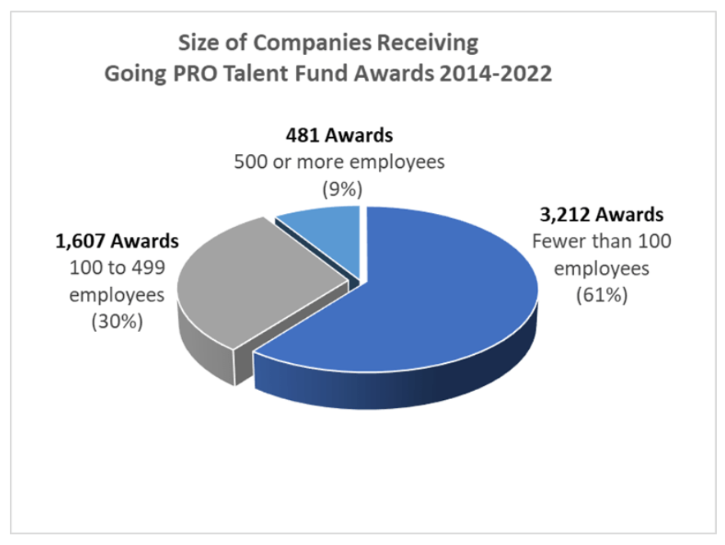
Overview
Opportunities for companies to be reimbursed for some of the cost of training full-time employees
$55 million has been appropriated for FY23
Maximum $500,000 per award
Last 9 years average award $32,499 used to reimburse for training an average of $1,096 per person
Competitive application process
No guarantee of funding nor approval
Not entitlement
Strict deadlines
Rules change every year and not yet finalized
Commitment beyond the application

Slide 4
FY23 Key Priorities
All training must lead to an industry led credential
Streamlined application
Scoring transparency
See the score; cutoff not disclosed
Multiple application cycles
Limited funds set aside for each cycle

Slide 5
Eligible Companies
Private sector (for profit or not-for-profit)
NO government nor tribal casinos
NO public institutions
NO local or intermediate school districts
NO municipally owned utilities
NO county road commissions, Community Mental Health
NO federally qualified health centers
Michigan presence
In compliance with federal/state tax obligations

Slide 6
Eligible Companies: Expectations
Hire/retain employees at completion of training
Pay wages >= current labor market for job title
Not to be used for low wage high turnover occupations
Training begins after award date
Applicable documentation submitted promptly after each training

Slide 7
Prohibited Expenditures
Purchase of tools, equipment, laptops, etc.
Books, supplies not included with tuition
Licensing fees
Testing fees
Curriculum development
Travel costs to attend training
Online training subscriptions
Consulting
Training prior to Talent Fund award date

Slide 8
Eligible Trainees
Full-time permanent employees 32+ hrs/wk
Existing employees on payroll 31+ days prior to award date, and/or
New employees hired 30 days prior, on, or after award date
Legally eligible to work in the USA
At least age 18
Company pays all applicable taxes to the State of Michigan, regardless of where trainee lives
If including employees that were on staffing agency payroll, and now on company’s payroll, must obtain new job or skills

Slide 9
Maximum Reimbursement
$2,000 per person
Existing employees in eligible classroom training that leads to certificate, certification, academic credit, or license
New employees in eligible classroom training that leads to certificate, certification, academic credit, or license
On the job training can only be included in addition to eligible classroom training

Slide 10
Maximum Reimbursement
$3,500 per USDOL registered apprentice
All active apprentices eligible, regardless of year
Classroom training and/or on the job training
Apprentice must officially be registered in RAPIDS before training

Slide 11
Incentive Bonuses
If training plan includes new hires, an extra $500 for hiring a veteran, active military reservist, older employee (55+), returning citizen, individual with disability, or public assistance recipient
New hire (onsite and/or classroom):
$2,000 + $500 = $2,500
USDOL registered apprentice:
$3,500 + $500 = $4,000
If someone will complete HS ed on work time is also on the training plan for some other form of training, an extra $1,000
MAXIMUM one incentive per person, even if they meet multiple categories
Submit documentation along with reimbursement requests

Slide 12
Eligible Training Providers
Classroom Training
Live, instructor-led (even if virtual)
Provides invoice and credential/certificate/certification/academic credit/ license
Must be outside (third party) vendor
MI community colleges, public/private colleges and universities
Private training providers
Labor unions, joint apprenticeship training centers
Proprietary schools licensed in MI
Vendors providing training that was not included in cost of new equipment/software
COMPANY selects the classroom training provider

Slide 13
Ineligible Classroom Training Topics
Soft skills (including time management, customer service, conflict resolution, business writing, communication)
Adult education, literacy
Basic/introductory overview
Language (other than ESL or ASL for work context only)
MS Outlook, Word, Excel, PowerPoint, OneNote, Access, Publisher
Laws, regulations, taxes
HR (diversity, coaching, listening, employee relations, emotional intelligence, culture, generations, ethics, sexual harassment, negotiation)
UNLESS USDOL registered apprenticeship

Slide 14
Ineligible Training
Seminars, conferences, workshops, continuing education credits
Online resources from which to choose courses over time; subscriptions
Online training that is self-paced
In-house training for existing employees
Wage reimbursement for onsite training of existing employees

Slide 15
Training Duration
Short term
No single training > 6 months
Complete all training <= 12 months from award date

Slide 16
Classroom Training Clarification
Leadership/Management/Supervision
MUST attach syllabus/curriculum summary that includes course objectives and competencies
Safety
NOT normal cost of doing business
Process Improvement/Risk & Quality Management
Black or Green belt preferred
MUST have hands-on component
Competency based
Examples of acceptable training include Lean, Six Sigma, Supply Chain, Total Quality Management

Slide 17
QUESTIONS SO FAR?

Slide 18
Scoring Criteria
Not yet available; objective categories
Priority industries
Agribusiness
Construction
Education
Energy
Healthcare
Hospitality/Outdoor Recreation
IT
Manufacturing
Mobility

Slide 19
Process
Company meets with Michigan Works!
Determine need for training, and
Appropriateness for Talent Fund expectations, and
If other funds are available
Company can choose one Michigan Works! for all applications, or the local Michigan Works! for each application
Company selects the best training
Establish MI Login or at least have active account on www.mitalent.org

Slide 20
Cycle 1
October ?
Request authorization in Talent Fund website, www.michigan.gov/talentfund
November ?
Application instructions released
November ?
Application opens
December ? (4:59pm EST)
Deadline to submit application
February 1, 2023 – January 31, 2024
Training can occur
No January 2023 training, even if college credit
**DATES SUBJECT TO CHANGE

Slide 21
Cycle 2
February 2023
Request authorization in Talent Fund website, www.michigan.gov/talentfund
March 2023
Application instructions released
April 2023
Application opens
April 2023 (4:59pm EST)
Deadline to submit application
July 1, 2023 – June 30, 2024
Training can occur
**DATES SUBJECT TO CHANGE

Slide 22
Application Process
Company starts the application after access is granted
Start and end dates for the entire plan
Classroom training
Provider name, city, public/private, credential or academic credit
Course titles
Enter the correct cost per person
Quantity of employees attending each course
Quantity of employees to be hired
Average hourly wage of trainees
Onsite training (if applicable)
New hire job titles
Average hourly wages
Quantity of hours to be trained

Slide 23
Application Process Continued
If application contains USDOL registered apprentice
Be sure to select “USDOL Registered Apprenticeship - Classroom” or “USDOL Registered Apprenticeship – OJT” for each applicable apprentice
NO other employees should be assigned to these categories
If apprentices and non-apprentices are taking the same courses, make sure that these courses are entered in BOTH Classroom/Customized training AND in “USDOL Registered Apprenticeship – Classroom” training

Slide 24
Application Process Continued
Company Contributions
Wages while in classroom training
Travel for classroom training
Books, supplies, certification exam fee that is not included in course cost
In-kind figure for use of conference room used for classroom training
Curriculum development
Online training subscriptions
Purchase of tools, equipment, laptops, etc., related to training
Only one year’s value of equipment purchased
Licensing fees
Consulting fees
Include the calculations in the application

Slide 25
Application Process Continued
Be CONSERVATIVE and REALISTIC
Quantity to be trained
Types of training; classroom training providers
Start and end dates of entire plan
Approvals are expected to be achieved as originally entered
Cannot transfer money between apprentices and non-apprentices

Slide 26
Application Process Continued
Submit Application
Deadline determined by the state computer’s clock
No extensions
No appeals

Slide 27
Process: After Company Submits
Michigan Works! review
If applicable, unlock it so company can edit
Michigan Works! submits application to state
State determines approval
State will be vetting company tax status through Dept. of Treasury
Includes fines and penalties
State announces the awards
May apply for Cycle 2 if not awarded in Cycle 1

Slide 28
If Awarded
After training ends
Give Michigan Works! documents needed for reimbursement and incentives
In Talent Fund website, enter:
Actual company contribution
Average hourly wages when training ends
Average hourly wages 6 months after training ends
Impact story

Slide 29
Industry-Led Collaborative
True formal collaboration through which a strategic effort determined that an issue shared by all the participating companies will be solved or positively addressed by the agreed upon classroom training
Formal organization or demonstrated history of partnership
Companies must include in their rationales how they will effectively collaborate with the other companies participating in the ILC after the training to solve the shared issue
Limited funds set aside
Classroom training only
2+ companies
Entirely separate application & scoring criteria
One independent award and one ILC award per location
ILC application likely released in early 2023

Slide 30
QUESTIONS SO FAR?

Slide 31
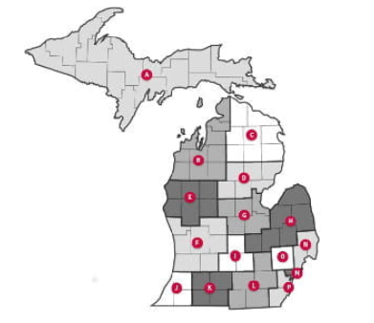
Next Steps
Meet with Michigan Works!
From the Talent Fund website, www.michigan.gov/TalentFund, scroll down and click on your region in the map of Michigan

Slide 32
How to Prepare
WHAT training is needed?
WHICH full-time existing employees need classroom training?
USDOL registered apprentices need training or will start in 2023?
full-time employees will be hired and need classroom training?
WHEN will training occur?
WHO will conduct training?
WHERE will training take place?
HOW will company contribute?
IS company current on state taxes?

Slide 33
Thank you
TERI SAND 517 – 492 – 5516 TSand@camw.net

