Slide 1
Avoid Winter Blues & Stay Out of the Red: A Guide to Managing Your Cash
Michigan Small Business Development Center

Slide 2
Introductions

Slide 3
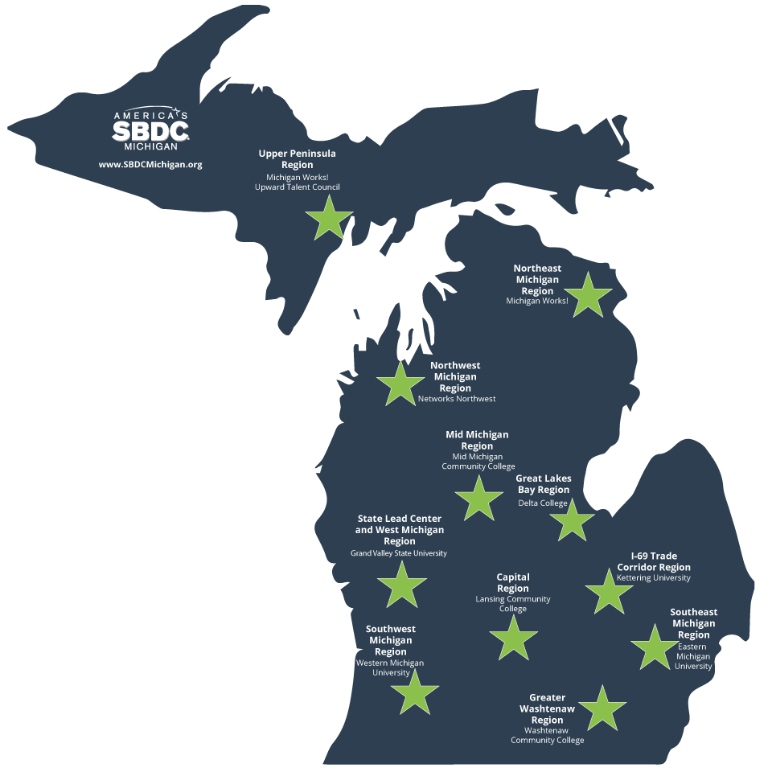
The Michigan SBDC
Funded through a cooperative agreement with the
U.S. Small Business Administration (SBA)
Michigan Economic Development Corporation (MEDC)
Matching funds from Local Network partners in each region.
John Schmitt
Southwest Michigan Region
Shawn Preissle
Greater Washtenaw Region
SBDCMichigan.org

Slide 4
Michigan SBDC Services
No cost 1:1 business consulting
Business education
Information-based planning through (secondary) market research
Technology commercialization
CARES Act Services (temporary)
Industry experts
Service providers
Contractors

Slide 5
Michigan SBDC Business Education
Take advantage of in-person and online learning opportunities for entrepreneurs. The MI-SBDC offers a variety of trainings presented by experienced professionals who can help you start and grow your business.
Register at SBDCMichigan.org/training
Topics Include:
Starting a Business
Business Plan
Financial and Accounting
Customer Relations
Government Contracting
Internet and Social Media
Legal
Management
Marketing and Sales

Slide 6
Objectives
Preparing a strategy for the next six months
Setting achievable goals
Learning the keys to developing a realistic cash flow forecast
Answering your questions

Slide 7
Understanding Cash Flow
Your Cash Flow is the way that money comes into and leaves your business.
While related to profit, it is different: you can be profitable and still run out of cash.
By completing a rigorous Cash Flow Projection you should know if you will have enough cash to make it through the next 4 – 6 months.

Slide 8
Understanding Cash Flow (continued)
If it looks like you won’t have enough cash, what steps can you take?
Make operational changes (more to follow)
Borrow money / seek investors
Cut your losses
Speak with a local MI-SBDC Business Counselor

Slide 9
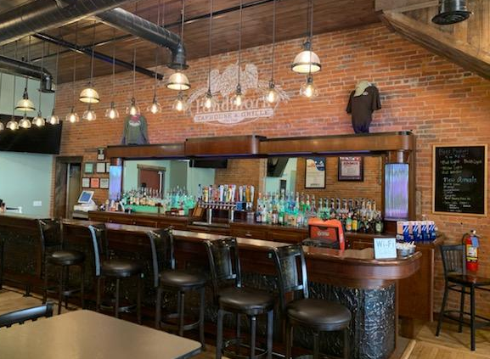
What do the next few months look like for Restaurants?
Notes:
COVID compliance
Supplier issues
9

Slide 10
Determine what your “long term” (4-6 months) goal is:
Provide essential service to your customers / town / employees
Restaurants often provide a semblance of normalcy
Stay afloat
Do enough business to cover your fixed costs and survive until Spring
Take advantage of potential opportunity
With many places closing, there may be a chance to “grow” your brand

Slide 11
To achieve your long-term goal, think “short term” (4-6 weeks) and what steps can you take.
Notes:
11
Consider who you are as a person: Being a business owner takes a certain kind of person – are you that type? These are some of the questions you need to ask yourself. There are no right or wrong answers to these questions.

Slide 12
Factors to consider when evaluating your options:
Sudden changes in State requirements
Seating capacity limitations
Customer perceptions of safety
Potential supply chain issues
Staffing issues
Outside dining no longer a viable option
High overhead and low revenues
Increased “plate” costs due to the cost of packaging

Slide 13
Take proactive steps to overcome obstacles to achieving your goal

Slide 14
Develop a Plan B
Provide delivery
Communicate regularly with your customer base
Don’t ease up on safety protocols
Reduce hours or days of the week to be opened
Get your menu online for ordering and payment
Consider reservations
Have your customers pre-order their food to maximize customer “turns”

Slide 15
Develop a Plan B (continued)
Consider adding a “Covid” or “PPE” surcharge
Consider changing your menu
Don’t worry about selling out of an item-that is good, no waste
Don’t assume diners need silverware napkins-ask
Daily inventory crucial-cut out the waste
Communicate regularly with your suppliers to get a heads up on shortages
Consider what you do best and do nothing else

Slide 16
How do these steps impact my cash flow?
A Cash Flow projection is simply “money in-money out”
Know your fixed costs (rent, utilities, insurance, etc.)
Fixed costs are often not in your control
Determine if there is any way you can reduce or eliminate these costs
You have some control on your variable costs
Food/beverage costs
Direct labor
Packaging costs
Project your sales revenue
What is your average ticket?
Use your POS to help with this
Keep in mind your average ticket may change if you change your menu
How many tickets can you reasonably do?
Be conservative
Remember your capacity may be different than in the past

Slide 17
Cash Flow Projections Tool
Notes:
What do you need to pay for Every week?
Estimate monthly expenses
Staff: wages, benefits, training
Promotions, advertising
Inventory, raw materials
Rent, utilities, insurance
Travel, delivery, supplies
Taxes
Loan repayment, interest
Document financial projections
Cash Flow
Profit & Loss
Balance Sheets
Breakeven Analysis
Estimate funding needs
Start-up costs
Monthly expenses
Financial Statement of Owner
Determine how you will fund your business (personal resources, friends, family, loan)
Your SBDC Consultant can assist you with a CashFlow spreadsheet to estimate your operating expenses and income projections.

Slide 18
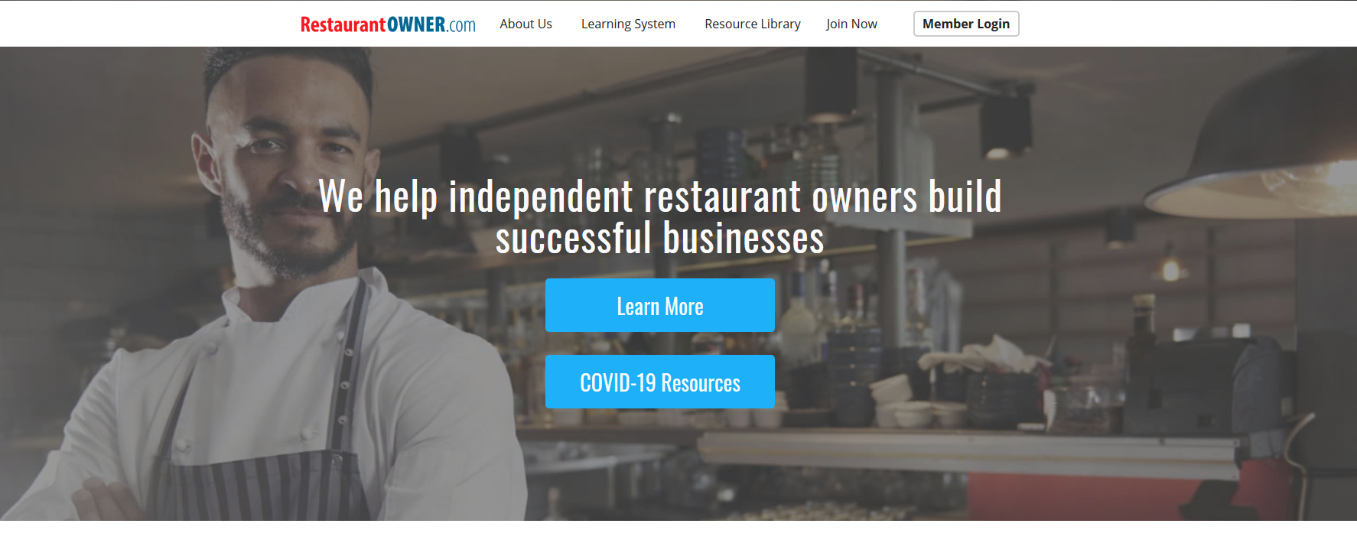
RestaurantOwner.com
To receive your 1-year free subscription, email Kory Scheiber at kscheiber@wccnet.edu or call 734-477-8762

Slide 19
Questions and Discussion

Slide 20
The Michigan SBDC
Funded through a cooperative agreement with the
U.S. Small Business Administration (SBA)
Michigan Economic Development Corporation (MEDC)
Matching funds from Local Network partners in each region.
John Schmitt
Southwest Michigan Region
269-387-6004
Shawn Preissle
Greater Washtenaw Region
734-249-5986
SBDCMichigan.org
Notes:
Add contact info.

